Slide 1
Java Capability
IO

Slide 2
Agenda
Introduction
Byte Stream & Character Stream
DataInputStream,FileInputStream,SequenceInputStream
FileWriter,FileReader,PrintWriter
Serialization & Deserialization
StreamTokenizer

Slide 3
Prerequisites
Basic programming skill
Java knowledge mandatory

Slide 4
Introduction
Java performs I/O through Streams. A Stream is linked to a physical layer by java I/O system to make input and output operation in java. In general, a stream means continuous flow of data. Streams are clean way to deal with input/output without having every part of your code understand the physical.
Java encapsulates Stream under java.io package. Java defines two types of streams. They are,
Byte Stream : It provides a convenient means for handling input and output of byte.
Character Stream : It provides a convenient means for handling input and output of characters. Character stream uses Unicode and therefore can be internationalized.

Slide 5
Some important Byte stream classes.
Stream class | Description
BufferedInputStream | Used for Buffered Input Stream.
BufferedOutputStream | Used for Buffered Output Stream.
DataInputStream | Contains method for reading java standard datatype
DataOutputStream | An output stream that contain method for writing java standard data type
FileInputStream | Input stream that reads from a file
FileOutputStream | Output stream that write to a file.
InputStream | Abstract class that describe stream input.
OutputStream | Abstract class that describe stream output.
PrintStream | Output Stream that contain print() and println() method

Slide 6
Some important Character stream classes.
Stream class | Description
BufferedReader | Handles buffered input stream.
BufferedWriter | Handles buffered output stream.
FileReader | Input stream that reads from file.
FileWriter | Output stream that writes to file.
InputStreamReader | Input stream that translate byte to character
OutputStreamReader | Output stream that translate character to byte.
PrintWriter | Output Stream that contain print() and println() method.
Reader | Abstract class that define character stream input
Writer | Abstract class that define character stream output

Slide 7
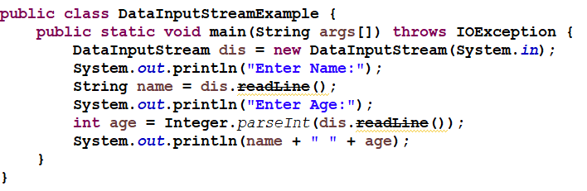
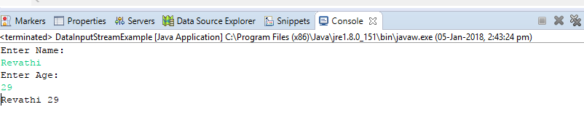
DataInputStream Example
Output

Slide 8
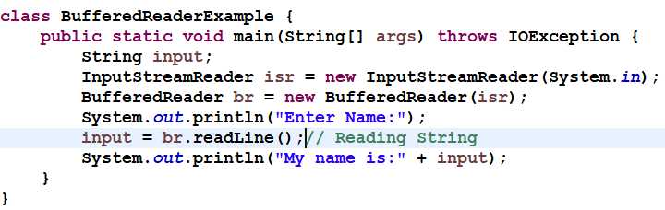
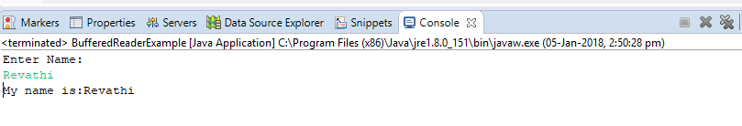
BufferedReader Example
Output

Slide 9
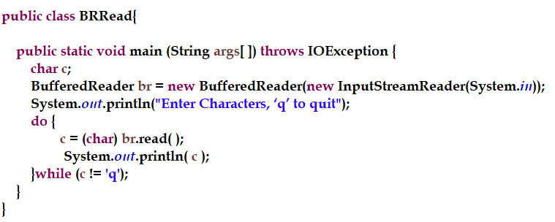
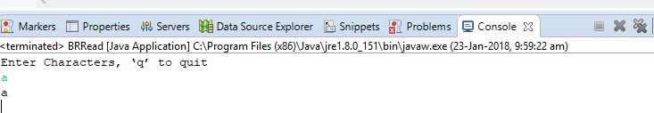
Reading Characters
Output:

Slide 10
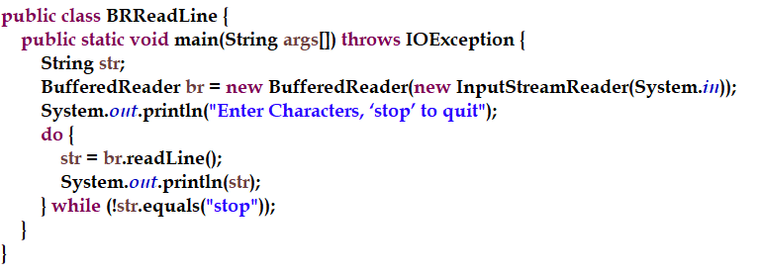
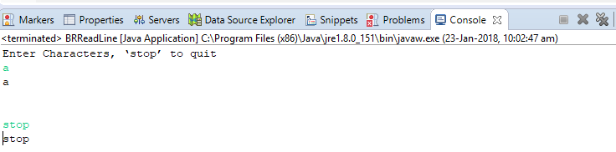
Reading Strings
Output:

Slide 11
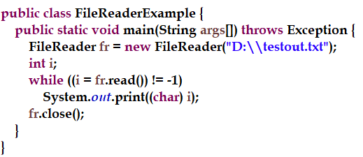
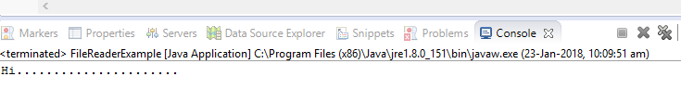
FileReader Example
Output

Slide 12
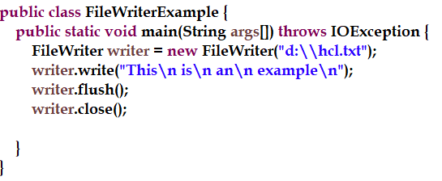
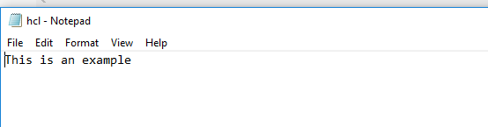
FileWriter Example
Output

Slide 13
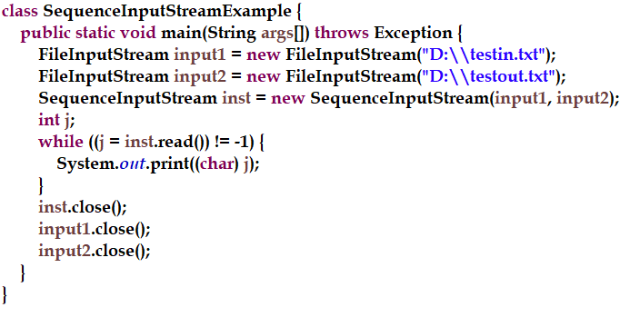
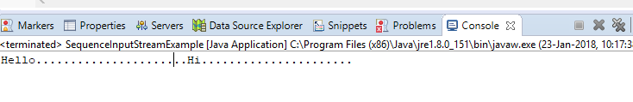
SequenceInputStream Example
Output:

Slide 14
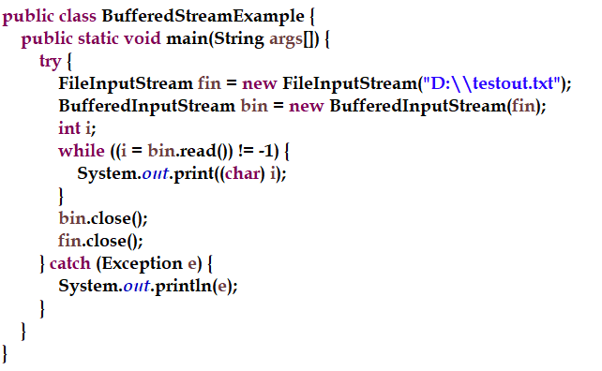
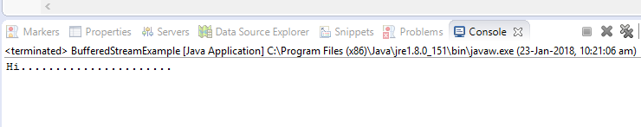
BufferedInputStream Example
Output:

Slide 15
PrintWriter class
Java PrintWriter class is the implementation of Writer class. It is used to print the formatted representation of objects to the text-output stream.

Slide 16
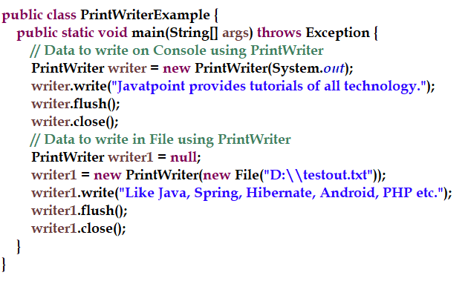
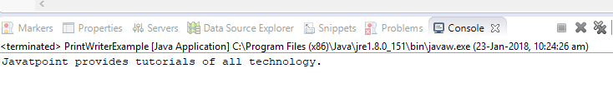
PrintWriter class Contd..
Output:

Slide 17
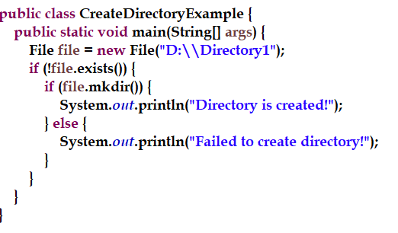
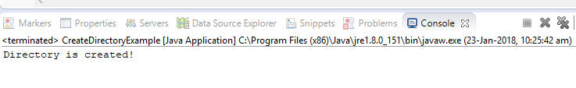
Creating Directories
Output:

Slide 18
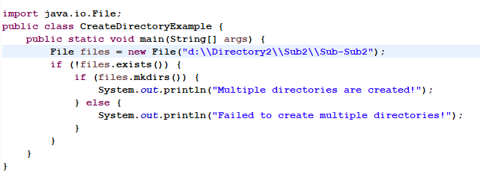
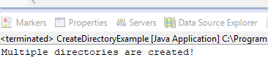
MULTIPLE DIRECTORIES
Output:

Slide 19
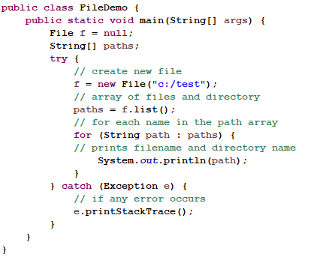
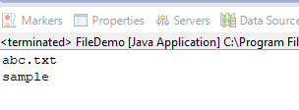
FILES
Output:

Slide 20
Serialization and Deserialization in Java
Serialization is a process of converting an object into a sequence of bytes which can be persisted to a disk or database or can be sent through streams. The reverse process of creating object from sequence of bytes is called deserialization.
Java provides Serializable API encapsulated under java.io package for serializing and deserializing objects which include,
java.io.serializable
java.io.Externalizable
ObjectInputStream
ObjectOutputStream etc.

Slide 21
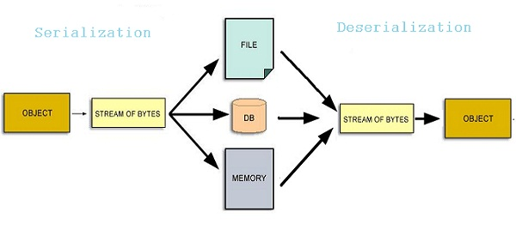
Serialization and Deserialization in Java

Slide 22
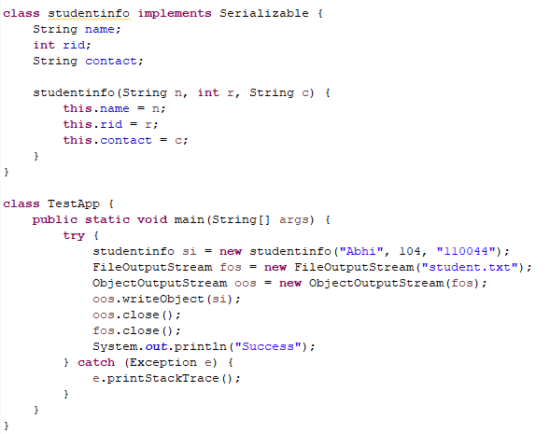
Serialization Example

Slide 23
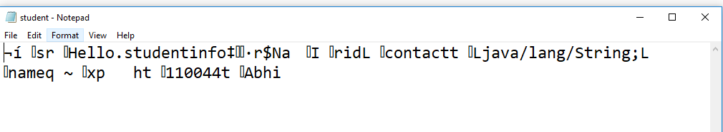
Serialization Example contd..
student.txt

Slide 24
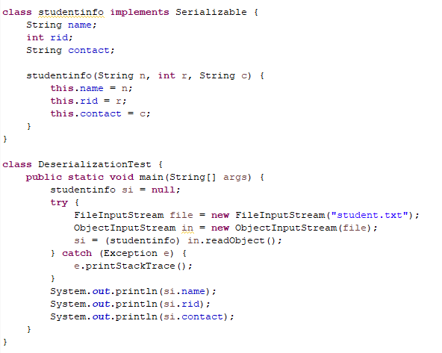
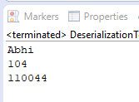
DeSerialization Example
Output:

Slide 25
Transient Example
If you don't want to serialize any data member of a class, you can mark it as transient. What fields cannot be serialized?
import java.io.Serializable;
public class Student implements Serializable{
int id;
String name;
transient int age;//Now it will not be serialized
public Student(int id, String name,int age) {
this.id = id;
this.name = name;
this.age=age;
}
}

Slide 26
StreamTokenizer Example
Check StringTokenizer also.
StreamTokenizer tokenizes the stream into distinct words and allows to read one by one. It is not a general tokenizer and includes the capability of knowing the type of the token like the token is a word or number.
nval : if current token is number, nval gives that number. sval : If current token is word, it gives the character of that word. TT_EOF : This is the point that represents that end of file has been read. TT_EOL : This represents that end of line has been read. TT_NUMBER : This represents that a number has been read. TT_WORD : This represents that word token has been read. ttype : This contains the type of the token which has been read.

Slide 27
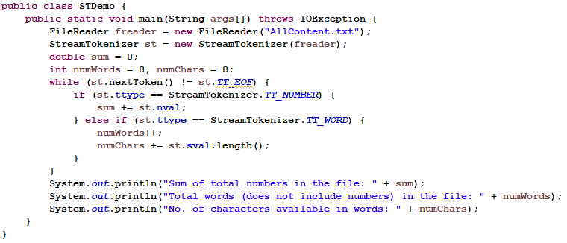
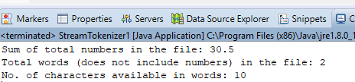
StreamTokenizer Example

Slide 28
Scanner Class
There are various ways to read input from the keyboard, the java.util.Scanner class is one of them.
It provides many methods to read and parse various primitive values.
Method | Description
public String next() | it returns the next token from the scanner.
public String nextLine() | it moves the scanner position to the next line and returns the value as a string.
public byte nextByte() | it scans the next token as a byte.
public short nextShort() | it scans the next token as a short value.
public int nextInt() | it scans the next token as an int value.
public long nextLong() | it scans the next token as a long value.
public float nextFloat() | it scans the next token as a float value.
public double nextDouble() | it scans the next token as a double value.

Slide 29
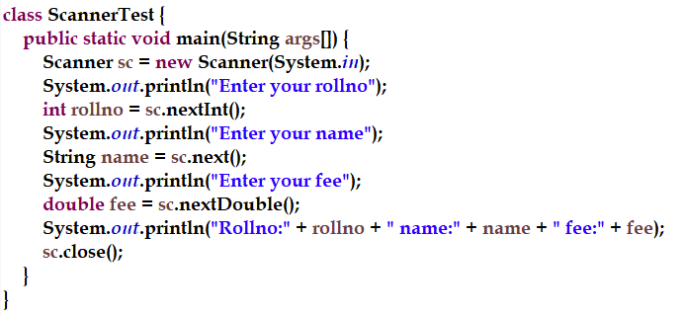
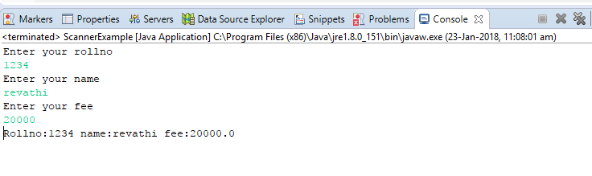
Scanner Example
Output:

Slide 30
Match the following
Match the streams with the appropriate phrases in column B
Column A Column B
FileWriter Byte stream for reading from file
FileInputStream Character stream for reading from file
FileOutputStream Character stream for writing to a file
FileReader Byte stream for writing to a file

Slide 31
INTRODUCTION
log4j is a reliable, fast and flexible logging framework (APIs) written in Java, which is distributed under the Apache Software License.
log4j has been ported to the C, C++, C#, Perl, Python, Ruby, and Eiffel languages.
log4j is highly configurable through external configuration files at runtime. It views the logging process in terms of levels of priorities and offers mechanisms to direct logging information to a great variety of destinations, such as a database, file, console, UNIX Syslog, etc.

Slide 32
Log4j components
loggers: Responsible for capturing logging information.
appenders: Responsible for publishing logging information to various preferred destinations.
layouts: Responsible for formatting logging information in different styles.

Slide 33
log4j Features
It is thread-safe.
It is optimized for speed.
It is based on a named logger hierarchy.
It supports multiple output appenders per logger.
It supports internationalization.
It is not restricted to a predefined set of facilities.

Slide 34
log4j - Architecture
log4j API follows a layered architecture where each layer provides different objects to perform different tasks. This layered architecture makes the design flexible and easy to extend in future.
There are two types of objects available with log4j framework.
Core Objects: These are mandatory objects of the framework. They are required to use the framework.
Support Objects: These are optional objects of the framework. They support core objects to perform additional but important tasks.

Slide 35
Core objects
Logger Object
The top-level layer is the Logger which provides the Logger object. The Logger object is responsible for capturing logging information and they are stored in a namespace hierarchy.
Layout Object
The layout layer provides objects which are used to format logging information in different styles. It provides support to appender objects before publishing logging information.
Appender Object
This is a lower-level layer which provides Appender objects. The Appender object is responsible for publishing logging information to various preferred destinations such as a database, file, console, UNIX Syslog, etc

Slide 36
Support Objects
Level Object
The Level object defines the granularity and priority of any logging information. There are seven levels of logging defined within the API: OFF, DEBUG, INFO, ERROR, WARN, FATAL, and ALL.
Filter Object
The Filter object is used to analyze logging information and make further decisions on whether that information should be logged or not.
An Appender objects can have several Filter objects associated with them. If logging information is passed to a particular Appender object, all the Filter objects associated with that Appender need to approve the logging information before it can be published to the attached destination.

Slide 37
Logging levels
ALL: All levels including custom levels also.
DEBUG: It helps developers in application debugging.
INFO: It gives the information about the progress of application and its states.
WARN: It gives warning for unexpected events.
ERROR: It provides the information about error events.
FATAL: It provides the information about application abort.
OFF: It turns off all the logging. It is opposite to the ALL level.
ALL < DEBUG < INFO < WARN < ERROR < FATAL < OFF.

Slide 38
Logging levels
i.e. If logging level set to FATAL then only FATAL messages will be displayed, if logging level set to ERROR then ERROR and FATAL messages will be displayed and so on.
In the below example as we set the logging level to WARN so only WARN, ERROR and FATAL messages will be displayed. The DEBUG and INFO message will not display.

Slide 39
log4j - Configuration
The log4j.properties file is a log4j configuration file which keeps properties in key-value pairs. By default, the LogManager looks for a file named log4j.properties in the CLASSPATH.
The level of the root logger is defined as DEBUG. The DEBUG attaches the appender named X to it.
Set the appender named X to be a valid appender.
Set the layout for the appender X.

Slide 40
log4j.properties Syntax
Define the root logger with appender X
log4j.rootLogger = DEBUG, X
# Set the appender named X to be a File appender
log4j.appender.X=org.apache.log4j.FileAppender
# Define the layout for X appender
log4j.appender.X.layout=org.apache.log4j.PatternLayout
log4j.appender.X.layout.conversionPattern=%m%n
Log4j.appender.X.File=demoApplication.log

Slide 41
APPENDERS
Apache log4j provides Appender objects which are primarily responsible for printing logging messages to different destinations such as consoles, files, sockets, NT event logs, etc.
Each Appender object has different properties associated with it, and these properties indicate the behavior of that object.

Slide 42
Appender PROPERTIES
Property | Description
layout | Appender uses the Layout objects and the conversion pattern associated with them to format the logging information.
target | The target may be a console, a file, or another item depending on the appender.
level | The level is required to control the filtration of the log messages.
threshold | Appender can have a threshold level associated with it independent of the logger level. The Appender ignores any logging messages that have a level lower than the threshold level.
filter | The Filter objects can analyze logging information beyond level matching and decide whether logging requests should be handled by a particular Appender or ignored.

Slide 43
Layout
DateLayout
HTMLLayout
PatternLayout
SimpleLayout
XMLLayout
Using HTMLLayout and XMLLayout, you can generate log in HTML and in XML

Slide 44
Logging Methods
# | Methods and Description
1 | public void debug(Object message) It prints messages with the level Level.DEBUG.
2 | public void error(Object message) It prints messages with the level Level.ERROR.
3 | public void fatal(Object message) It prints messages with the level Level.FATAL.
4 | public void info(Object message) It prints messages with the level Level.INFO.
5 | public void warn(Object message) It prints messages with the level Level.WARN.
6 | public void trace(Object message) It prints messages with the level Level.TRACE.

Slide 45
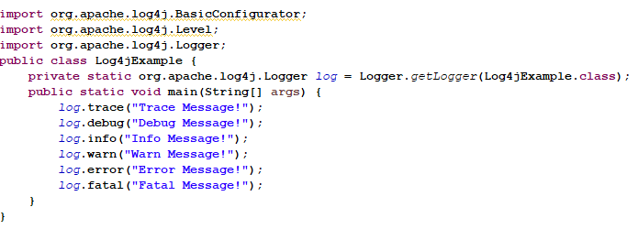
Example

Slide 46
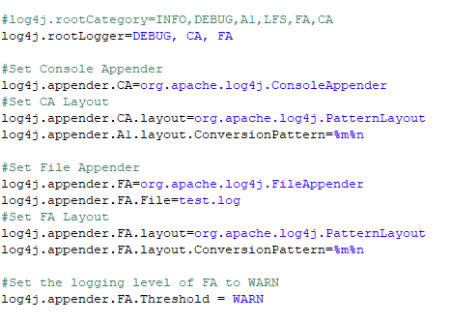
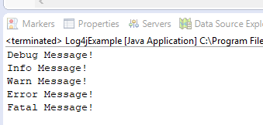
Example
Output:

Slide 47
References & Further Studies
https://docs.oracle.com/javase/7/docs/api/java/io/package-summary.html
http://www.tutorialspoint.com/java/io/
https://www.java4s.com/log4j-tutorials/log4j-example-on-using-fileappender-and-consoleappender-simultaneously/
http://www.javatutorialpoint.com/2017/07/log4j-tutorial-pdf.html

